Slide 1



CODE GENIE
MILESTONE – 2
Name: By Pranav K
Roll No. : 23BD1A661K
Group: 335

Slide 2
MAJOR LEARNINGS
Technical Skills
Gained understanding of building VS Code extensions using the vscode API.
LLM Integration
Improved skills in TypeScript and REST API communication with inference servers.
Implemented features like:
Code Autocompletion
Prompt-based Generation
Fill in the Middle suggestions
Understood the challenges of working with code generation models.
Learned how to structure prompt engineering specifically for developer tools.
Gained experience in handling token limits, streaming responses and contextual relevance.

Slide 3
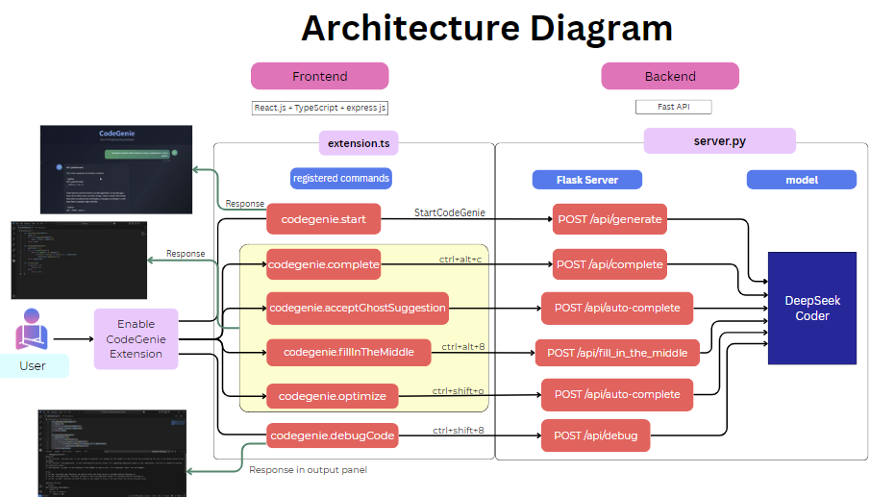
ARCHITECURE CHANGES
Original Plan:
Use Ollama with DeepSeek Coder.
Revised Plan:
Not using Ollama due to limitations.
Directly downloaded and ran DeepSeek Coder 1.3b model through Flask API.

Slide 4
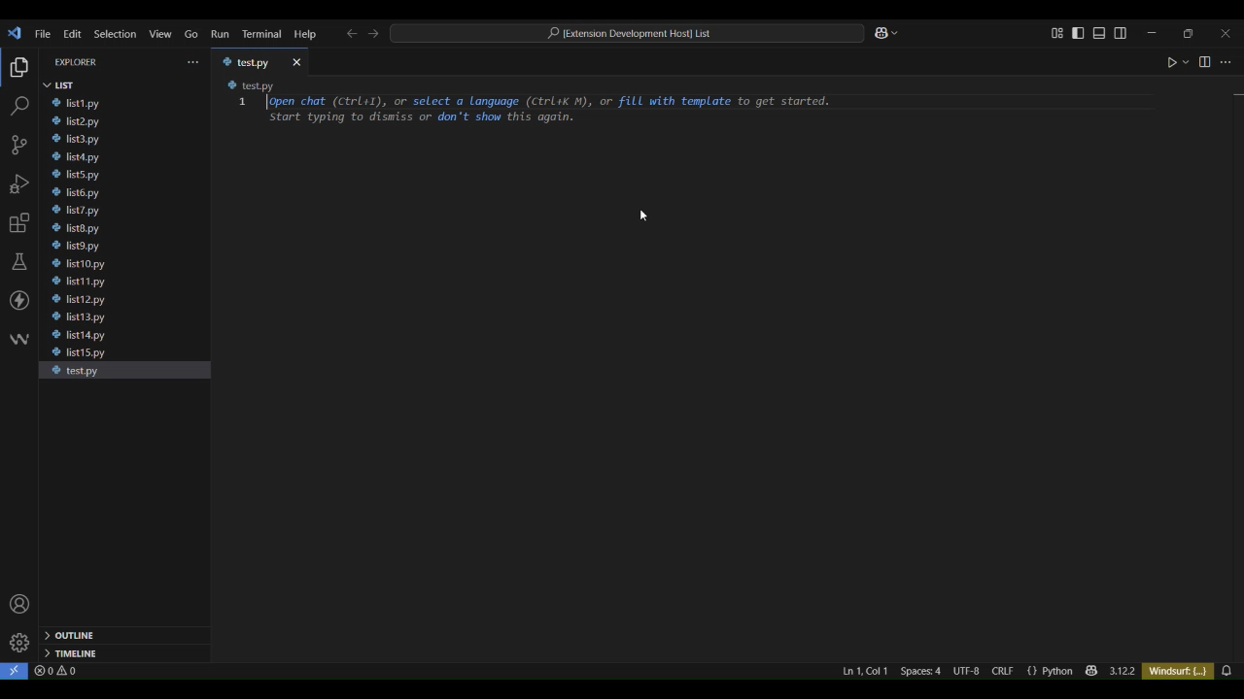

Slide 5
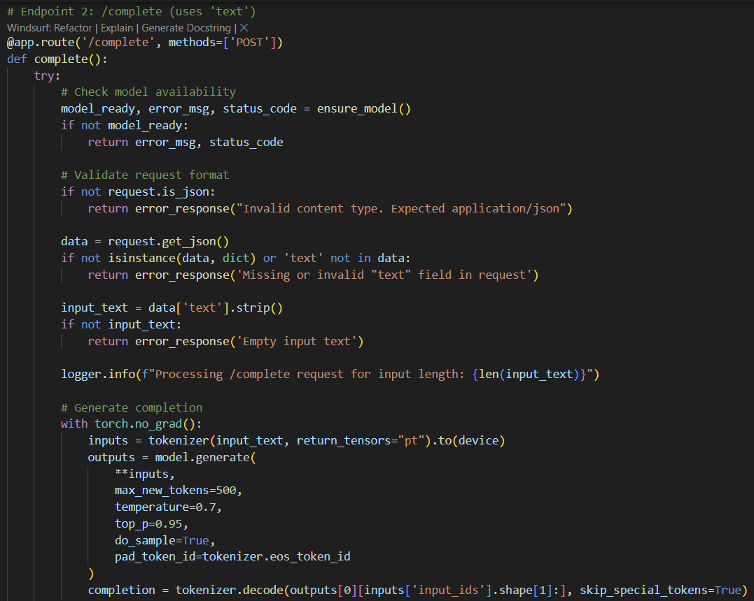
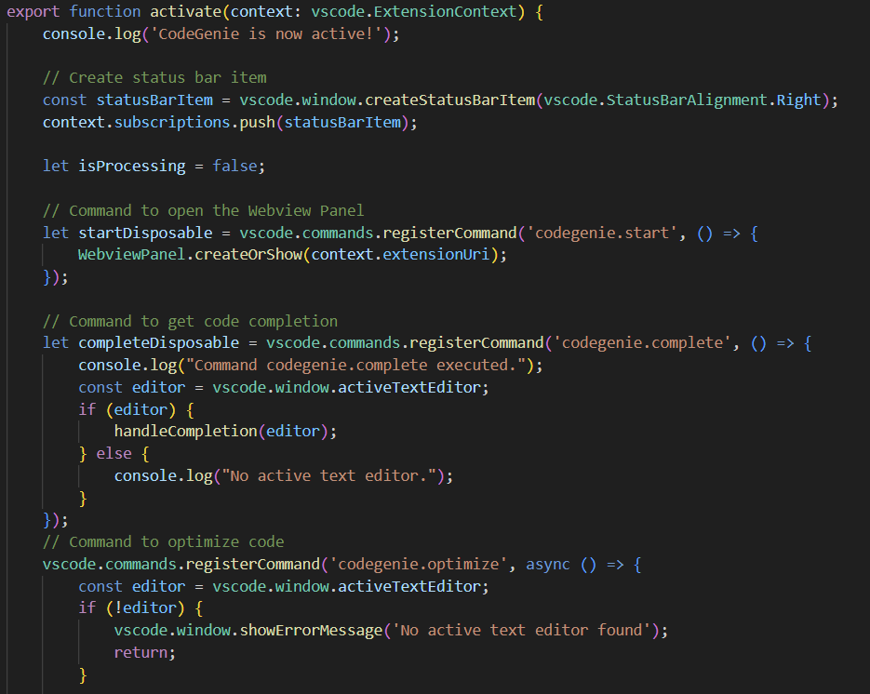
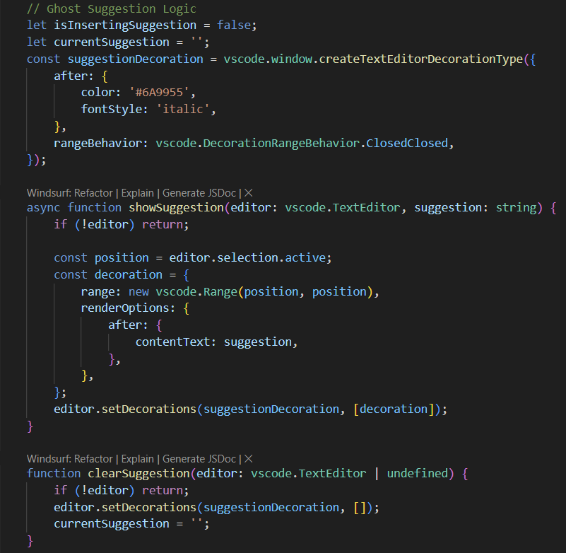
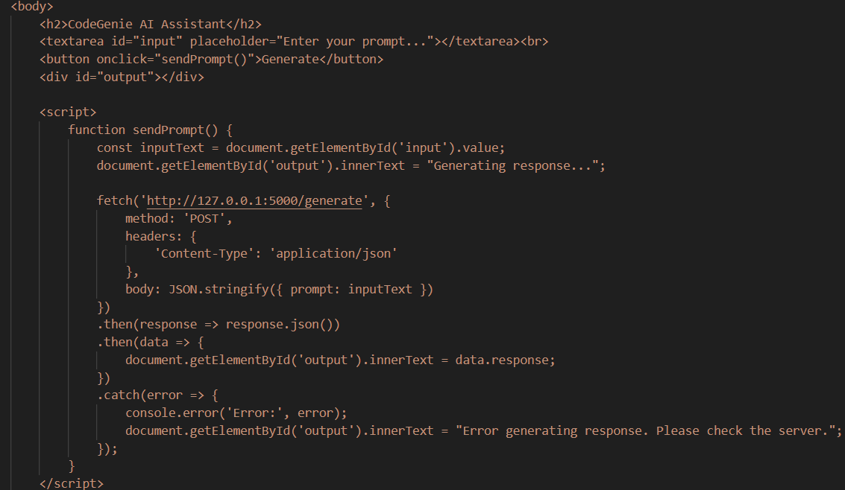

Slide 6
Challenges & Hurdles
Challenges | Description
VS Code API Complexity | Understanding the full structure and capabilities of the vscode extension API took time.
Performance Limitations | Due to lack of a dedicated GPU, responses were slower, affecting live user experience during testing.
Inserting Code Seamlessly | Inserting and replacing code in the editor without breaking user flow was technically tricky.
Backend | Building and connecting the Fast API backend.

Slide 7
Why DeepSeek Coder?
Deployment Approach
Project Specific Requirement
Specialized for code
Open source and easily accessible
Has multiple types of models
🛠️ 1. Final Deployment Target:
Published to VS Code Marketplace
Allows users to install directly from within VS Code.
Enables version control, updates, and discoverability.
🧰 2. Packaging & Publishing Process:
Used vsce (Visual Studio Code Extension CLI) to:
Package the extension.
Publish with a personal access token.
Other models researched
Code Llama (by Meta)
StarCoder
WizardCoder

Slide 8

THANK
YOU

